Slide 1

On the History of ALD and the VPHA project
The 14th International Baltic Conference on Atomic Layer Deposition
Riikka L. Puurunen,¹ Yury Koshtyal,² Henrik Pedersen,³ J. Ruud van Ommen,⁴ Oksana Yurkevich,⁵ Jonas Sundqvist⁶
¹ VTT Technical Research Centre of Finland, Espoo, Finland
² Ioffe Institute, St. Petersburg, Russia
³ Linköping University, Linköping, Sweden
⁴ Delft University of Technology, Delft, the Netherlands
⁵ Immanuel Kant Baltic Federal University, Kaliningrad, Russia
⁶ System Integration and Technology Transfer, Fraunhofer Institute for Ceramic Technologies and Systems IKTS, Dresden, Germany
Notes:
Добрый день дамы и господа (Good day ladies and gentlemen; Dobriy den dami i gospoda) My name is Riikka Puurunen and so on...

Slide 2
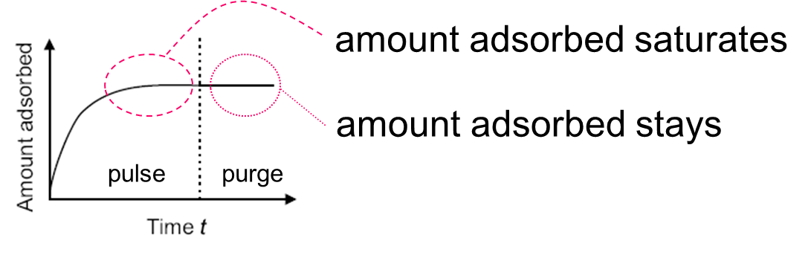
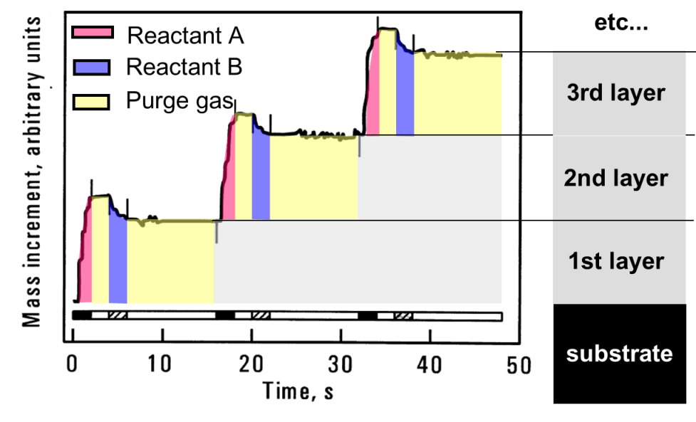
Atomic Layer Deposition (ALD): a chemical gas-phase technique for thin film growth
* saturating, irreversible chemisorption reactions
* repeated
Adapted with permission from: Aarik et al., Thin Solid Films 340 (1999) 110.

Slide 3
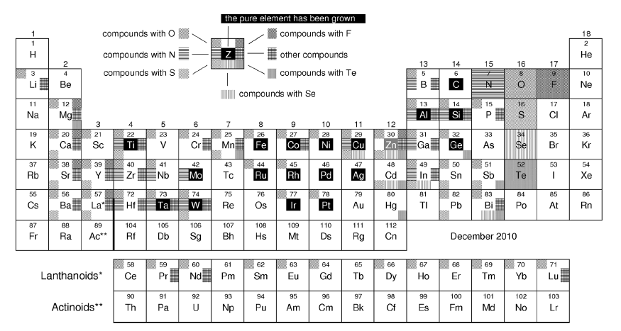
Many classes of materials have been studied by ALD: oxides, nitrides, sulfides, metals, …
!
Drozd
Source: review by Miikkulainen, Leskelä, Ritala, Puurunen, J. Appl. Phys. 113, 021301 (2013); >2000 references. http://dx.doi.org/10.1063/1.4757907

Slide 4
ALD discovered & developed independently
under two names
Atomic layer epitaxy (ALE), Finland, 1974 →
Molecular layering (ML), Soviet Union, 1960s →
  Молекулярное наслаивание (Мн), transliterated as molekulyarnoye naslaivanie
Especially ML has remained poorly known and cited
Virtual Project on the History of ALD (VPHA)
Goal of this presentation: summarize the of
key achievements in VPHA 2013-2016

Slide 5
Web of Science, Sept. 30, 2016
Knez, Nielsch, Niinistö, Adv. Mat. 2007
“Atomic layer deposition (ALD), originally called Atomic layer epitaxy (ALE), was developed in the 1970s by Suntola and Antson…”
(Times cited: 426)
George, Chemical Reviews 2010
”The history of ALE and ALD dates back to the 1970s in Finland.”
(Times cited: 1340)
Notes:
George: 1st most cited; Knez: 7th most cited

Slide 6
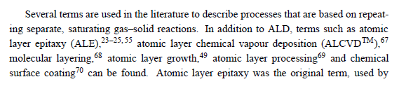
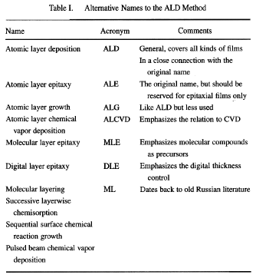
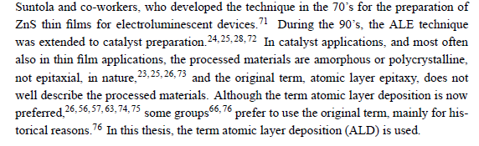
Puurunen, Doctoral thesis, Helsinki University of Technology, 2002
Ritala, M. & Leskelä, M. Nalwa, H. S. (Ed.) Atomic Layer Deposition Handbook of Thin Film Materials, Academic Press, 2002, 1, 103-159
”Early work on Atomic Layer Deposition cited” Malygin, Smirnov, Solid State Technology, 2002, March, p. 14
Puurunen, J. Appl. Phys. 2005
“TABLE I. Some Soviet–Russian ALD investigations.”

Slide 7
Puurunen, J. Appl. Phys. 2005
“According to the more commonly acknowledged origin, ALD was developed under the name “atomic layer epitaxy (ALE)” in Finland by Suntola and co-workers. “
“The less commonly acknowledged origin of ALD dates back to … the Soviet Union … 1960s …
group of Professor Aleskovskii.”
(Times cited: 1017)
Web of Science, Sept. 30, 2016
Knez, Nielsch, Niinistö, Adv. Mat. 2007
“Atomic layer deposition (ALD), originally called Atomic layer epitaxy (ALE), was developed in the 1970s by Suntola and Antson…”
(Times cited: 426)
George, Chemical Reviews 2010
”The history of ALE and ALD dates back to the 1970s in Finland.”
(Times cited: 1340)

Slide 8
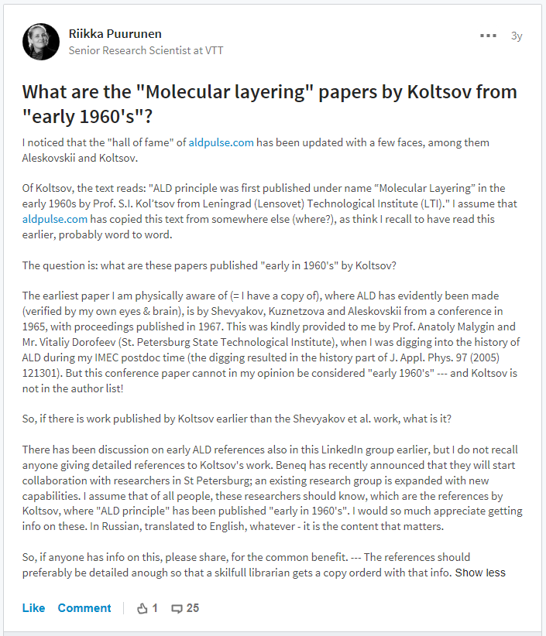
LinkedIn question May 6, 2013
LinkedIn ”ALD - Atomic Layer Deposition” group
https://www.linkedin.com/groups/1885076/1885076-238399494

Slide 9
LinkedIn question May 6, 2013
VPHA opened July 25, 2013 + ALD 2013 San Diego
Atomic layer deposition (ALD) has become a technique that, for its part, changes the world we live in. As for any significant technology, it is interesting and important to know where the technique came from. How was the concept developed? What were the first ALD experiments? When, where and by whom were they made? Why were they made?
First, we should generate a complete list of early ALD publications.
Second, interested individuals should pick up some of the early publications, read them, and comment on the work. For example: was ALD made (i.e., do you recognize the work as ALD), and if yes, which process it was; and other noteworthy things.
Third, the individual should share their comments with others, and the comments of different people should be collected together.
Atmosphere of Openness, Respect, and Trust
http://vph-ald.com/Introduction%20and%20invitation%20to%20participate.html

Slide 10
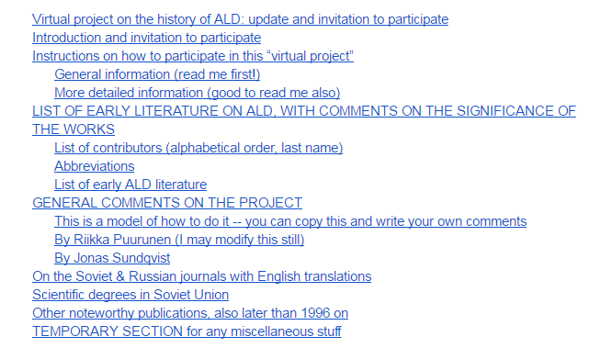
VPHA opened July 25, 2013 + ALD 2013 San Diego
ALD-history-evolving-file
Early ALD literature up to 1986
Curretly: ~300 pages
https://docs.google.com/document/d/1AlJg29dJM2if4SGzMJSSmwZskCNaAMQMO9LU6UYPios/

Slide 11

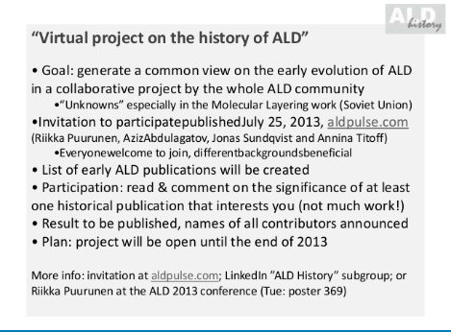
VPHA opened July 25, 2013 + ALD 2013 San Diego
http://www2.avs.org/conferences/ALD/2013/index.html
Announcement made by the
conference chair Prof. Kim

Slide 12
VPHA opened July 25, 2013 + ALD 2013 San Diego
Puurunen, J. Appl. Phys. 2005
“According to the more commonly acknowledged origin, ALD was developed under the name “atomic layer epitaxy (ALE)” in Finland by Suntola and co-workers. “
“The less commonly acknowledged origin of ALD dates back to … the Soviet Union … 1960s …
group of Professor Aleskovskii.”
(Times cited: 1017)
Web of Science, Sept. 30, 2016
Knez, Nielsch, Niinistö, Adv. Mat. 2007
“Atomic layer deposition (ALD), originally called Atomic layer epitaxy (ALE), was developed in the 1970s by Suntola and Antson…”
(Times cited: 426)
George, Chemical Reviews 2010
”The history of ALE and ALD dates back to the 1970s in Finland.”
(Times cited: 1340)
Parsons, Elam, George, Haukka, Jeon, Kessels, Leskelä, Poodt, Ritala, Rossnagel, JVST A 2013
“The ALD principle… was first published under name “molecular layering” in the early 1960s”
“A planar thin film was not produced or evaluated.”
Published:
16.8.2013
(Times cited: 12)
Notes:
Conference Chairs
Jiyoung Kim University of Texas at Dallas
Paul Ma Applied Materials

Slide 13
LinkedIn question May 6, 2013
VPHA opened July 25, 2013 + ALD 2013 San Diego
Publication Plan October 18, 2013 (updated Jan 13, 2014 & April 5, 2015)
1) Poster at Baltic ALD 2014
2) Poster at ALD 2014, Kyoto
3) Presentation at ALD 2014, Kyoto
4) ALD history tutorial at ALD 2014, Kyoto
5) Essay on the early history of ALE-ALD
6) Website for ALD history and VPHA
7) Exhibition: 40 years of ALD in Finland - Photos, Stories (FinALD40)
8) Review article/essay on the early history of ML-ALD
9) Presentation at ALD 2016
10) Optional: general ALD history review article
11) Updating wikipedia
12) Closing the VPHA
1) Poster at Baltic ALD 2014
2) Listing the early works at the aldpulse.com site
3) Poster at ALD 2014, Kyoto
4) Oral(?) presentation at ALD 2014, Kyoto
5) A review article on the early history of ALD
6) Updating wikipedia
1) Poster at Baltic ALD 2014
2) Listing the early works at the aldpulse.com site
3) Poster at ALD 2014, Kyoto
4) A review article on the early history of ALD in English
5) A review article on the early history of ALD in Russian
6) Oral presentation at Kyoto 2014?
7) Updating wikipedia
http://vph-ald.com/Publication%20Plan.html

Slide 14
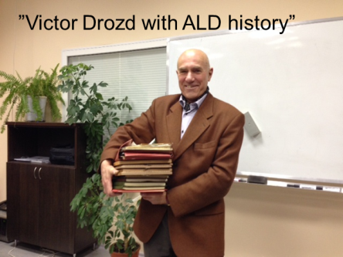
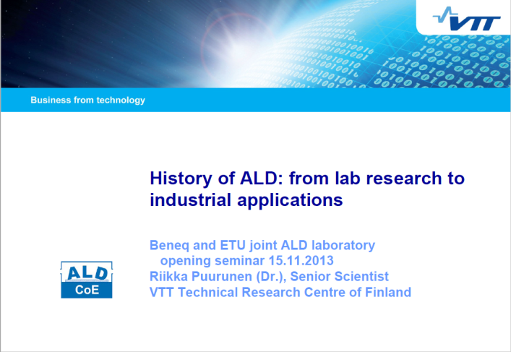
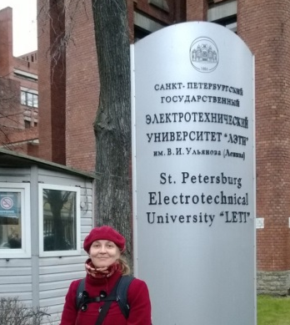
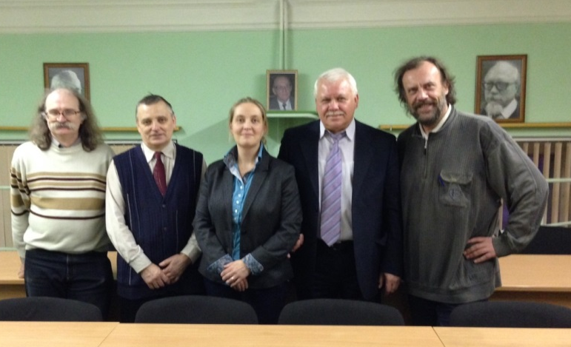
LinkedIn question May 6, 2013
VPHA opened July 25, 2013 + ALD 2013 San Diego
Publication Plan October 18, 2013 (updated Jan 13, 2014 & April 5, 2015)
Puurunen visit to St. Petersburg November 2013
Malygin laboratory

Slide 15
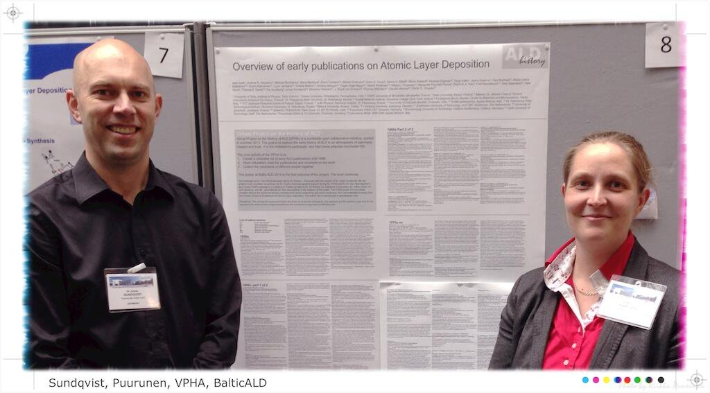
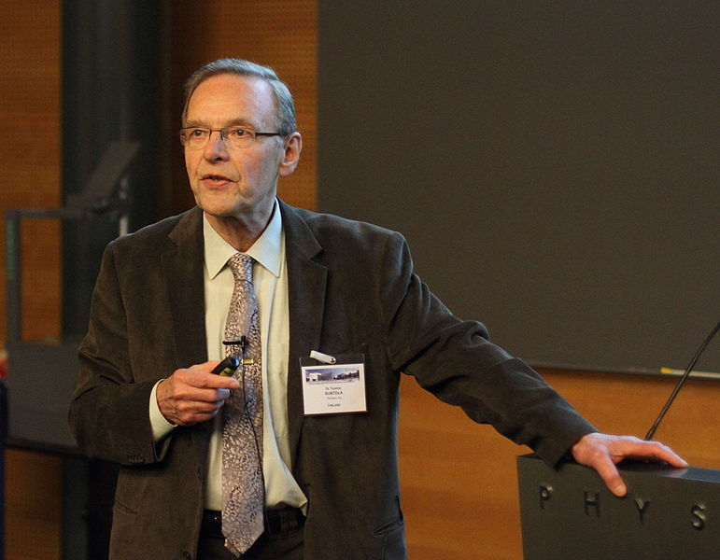
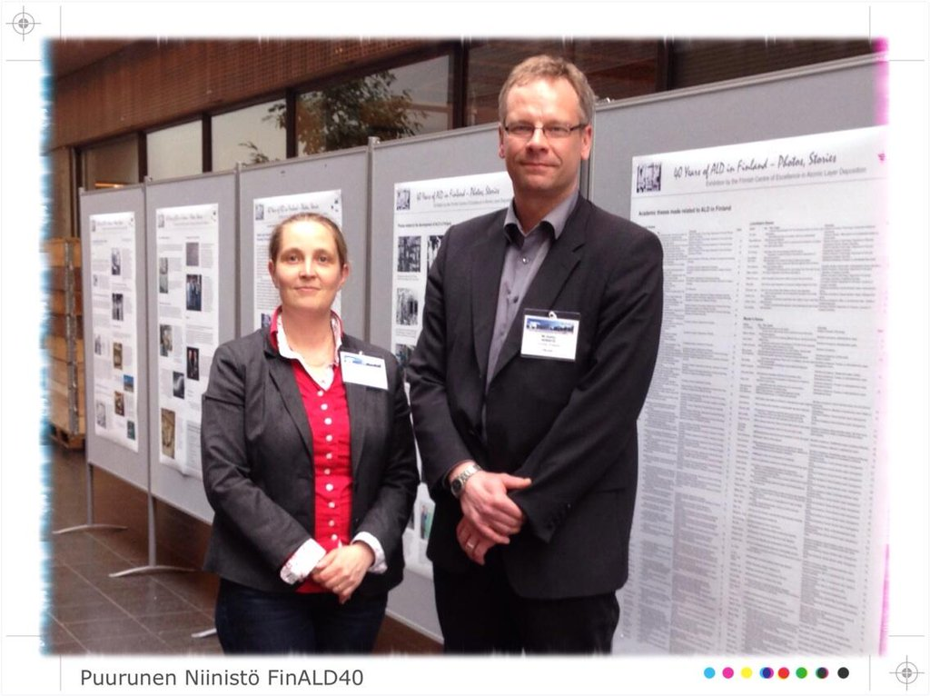
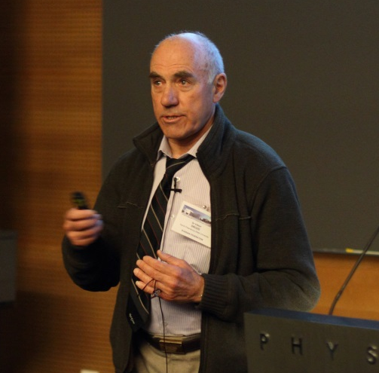
LinkedIn question May 6, 2013
VPHA opened July 25, 2013 + ALD 2013 San Diego
Publication Plan October 18, 2013 (updated Jan 13, 2014 & April 5, 2015)
Puurunen visit to St. Petersburg November 2013
Baltic ALD 2014 Helsinki: VPHA poster + FinALD40 exhibition
Suntola
Drozd
https://twitter.com/rlpuu/status/471248727471325185
https://commons.wikimedia.org/wiki/File:Tuomo_Suntola,_2014.JPG
Photo by Riikka Puurunen
https://twitter.com/rlpuu/status/471918113479348226
Access through:
http://vph-ald.com/ALD-history-publications.html

Slide 16
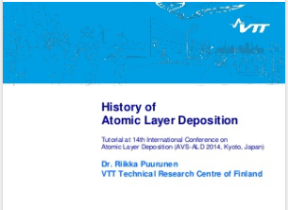
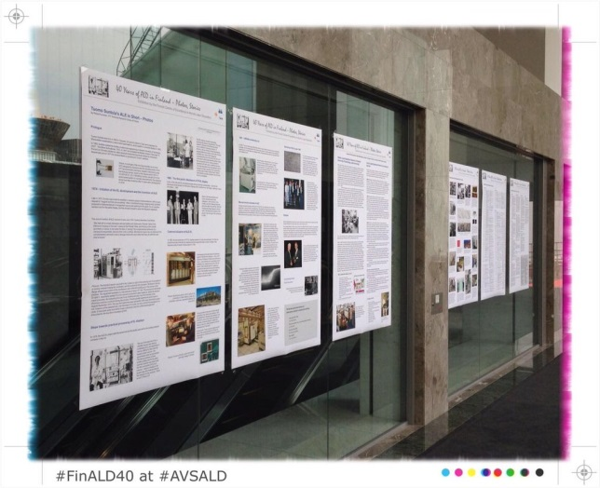
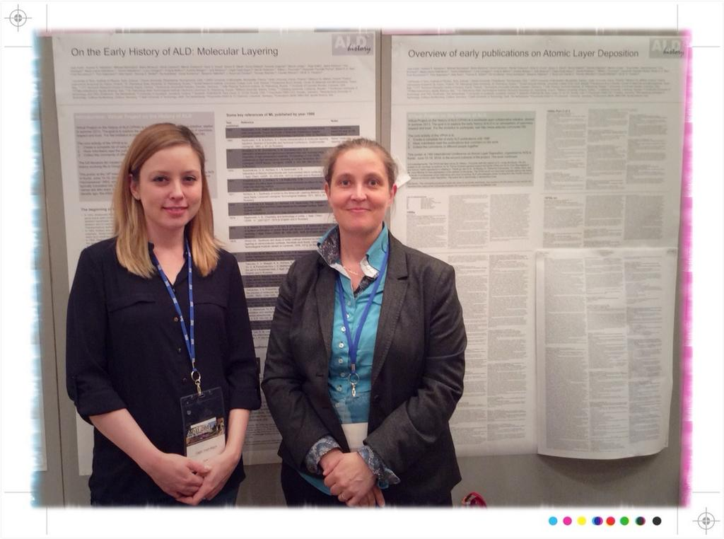
LinkedIn question May 6, 2013
VPHA opened July 25, 2013 + ALD 2013 San Diego
Publication Plan October 18, 2013 (updated Jan 13, 2014 & April 5, 2015)
Puurunen visit to St. Petersburg November 2013
Baltic ALD 2014 Helsinki: VPHA poster + FinALD40 exhibition
ALD 2014 Kyoto: history tutorial + two posters
https://twitter.com/rlpuu/status/478367321572913152
https://twitter.com/rlpuu/status/509792544373620736
Access through:
http://vph-ald.com/ALD-history-publications.html

Slide 17
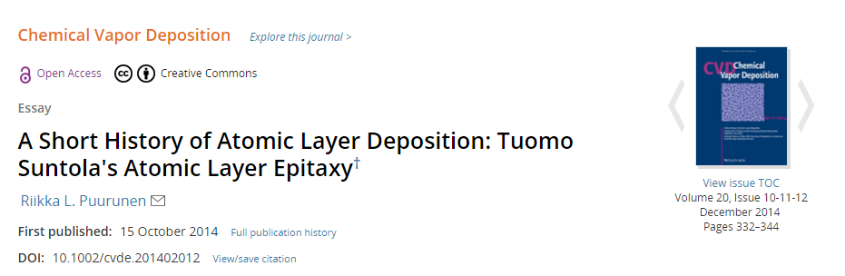
LinkedIn question May 6, 2013
VPHA opened July 25, 2013 + ALD 2013 San Diego
Publication Plan October 18, 2013 (updated Jan 13, 2014 & April 5, 2015)
Puurunen visit to St. Petersburg November 2013
Baltic ALD 2014 Helsinki: VPHA poster + FinALD40 exhibition
ALD 2014 Kyoto: history tutorial + two posters
”Suntola’s ALE essay” published Oct 15, 2014 & FinALD40 release
10.1002/cvde.201402012/full

Slide 18
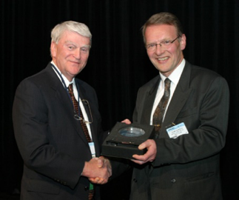
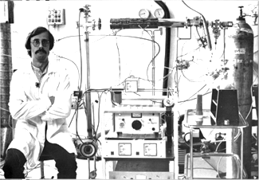
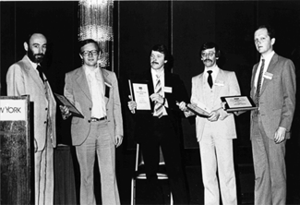
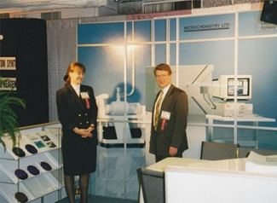
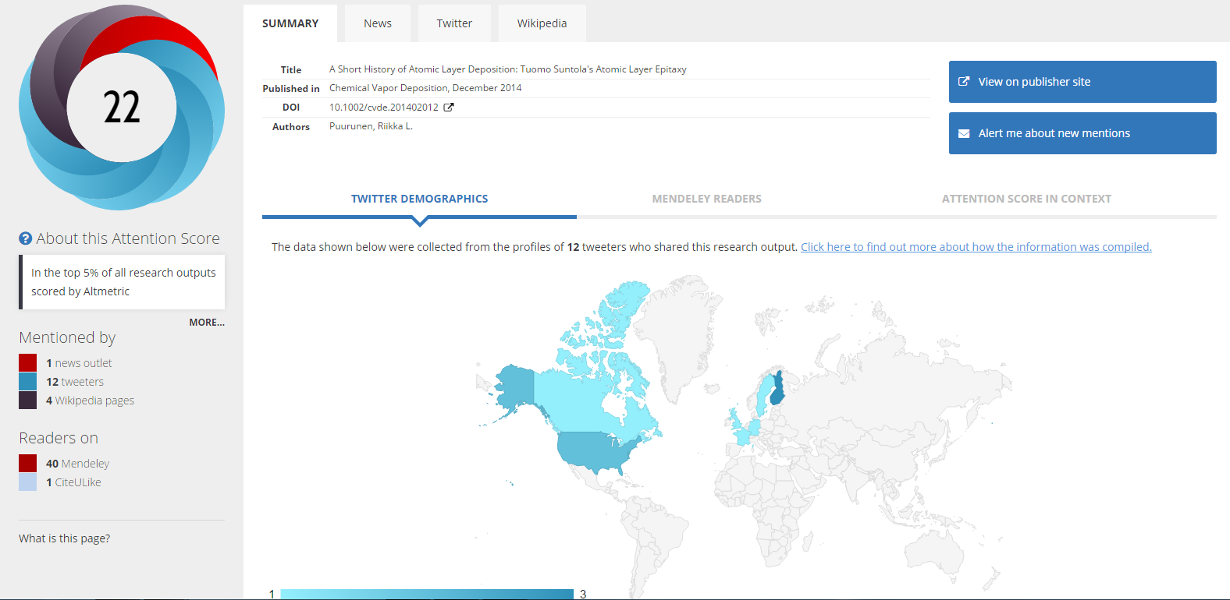
”Suntola’s ALE essay” published Oct 15, 2014 & FinALD40 release
1978 Sven Lindfors & flow reactor
Suntola Antson Lindfors
Pakkala SID conf. 1981
European SEMI Award
to Suntola 2004
Microchemistry's at the MRS
1994, Boston
10.1002/cvde.201402012/full
Times cited: 7
Notes:
Sven Lindfors in 1978 next to the flow-type ALD reactor in which the successful H₂S/ZnCl₂process was demonstrated.
SID representative and Tuomo Suntola and his key colleagues, (from left to right) Jorma Antson, Sven Lindfors, and Arto Pakkala, who received the 1980 SID Outstanding Paper Award for the EL work. The Award was handed to the group at the following year SID conference in 1981. Photo from Suntola's collections; published with permission of Tuomo Suntola (private collection).
Microchemistry's ALE booth at the MRS 1994 Annual Meeting in Boston. In the picture (left) Heli Vaara, assistant to (right) Tuomo Suntola. Photo from Suntola's collections; published with permission of Tuomo Suntola (private collection).
The European SEMI Award was awarded to Suntola (right) at the Munich Electronics Show 2004 by Stanley Myers, the President & CEO of SEMI (USA) (left).

Slide 19
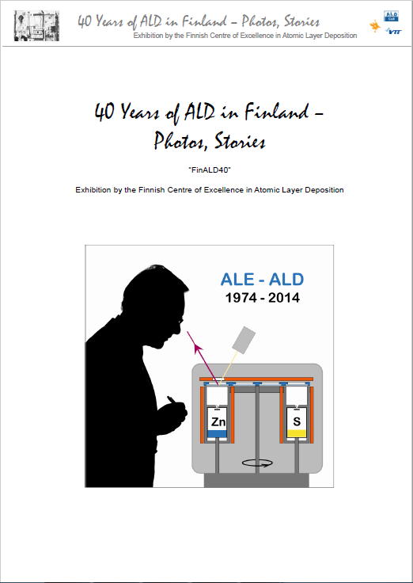
”Suntola’s ALE essay” published Oct 15, 2014 & FinALD40 release
Released Nov 29, 2014
Preface Markku Leskelä
Tuomo Suntola’s ALE in Short
ALD research at Helsinki University of Technology
ALD research at University of Helsinki
Photos related to ALD research
Academic ALD theses in Finland
Organizations active with ALD in Finland
Stories: Story on ZyALD
Access through:
http://aldcoe.fi
http://vph-ald.com

Slide 20
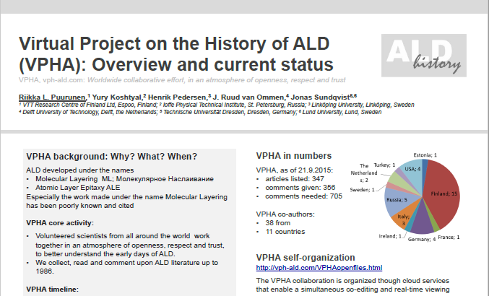
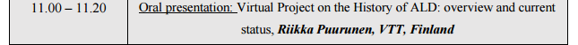
LinkedIn question May 6, 2013
VPHA opened July 25, 2013 + ALD 2013 San Diego
Publication Plan October 18, 2013 (updated Jan 13, 2014 & April 5, 2015)
Puurunen visit to St. Petersburg November 2013
Baltic ALD 2014 Helsinki: VPHA poster + FinALD40 exhibition
ALD 2014 Kyoto: history tutorial + two posters
”Suntola’s ALE essay” published Oct 15, 2014 & FinALD40 release
ALD Russia Moscow
+ Baltic ALD Tartu Sep-Oct 2015
Access through:
http://vph-ald.com/ALD-history-publications.html

Slide 21
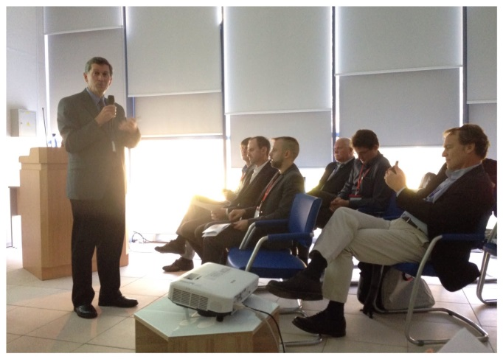
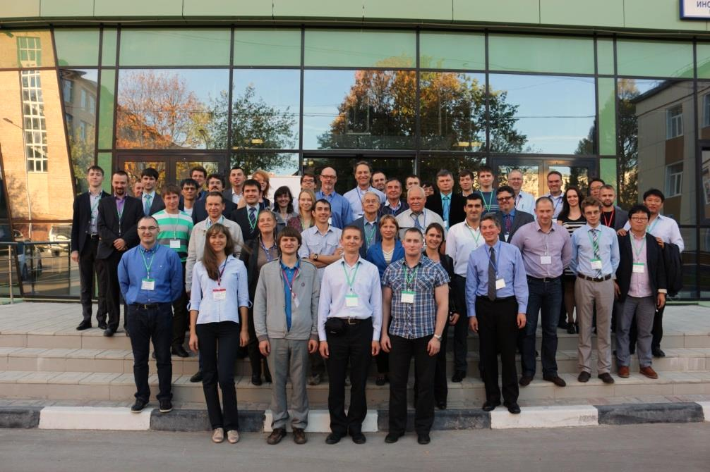
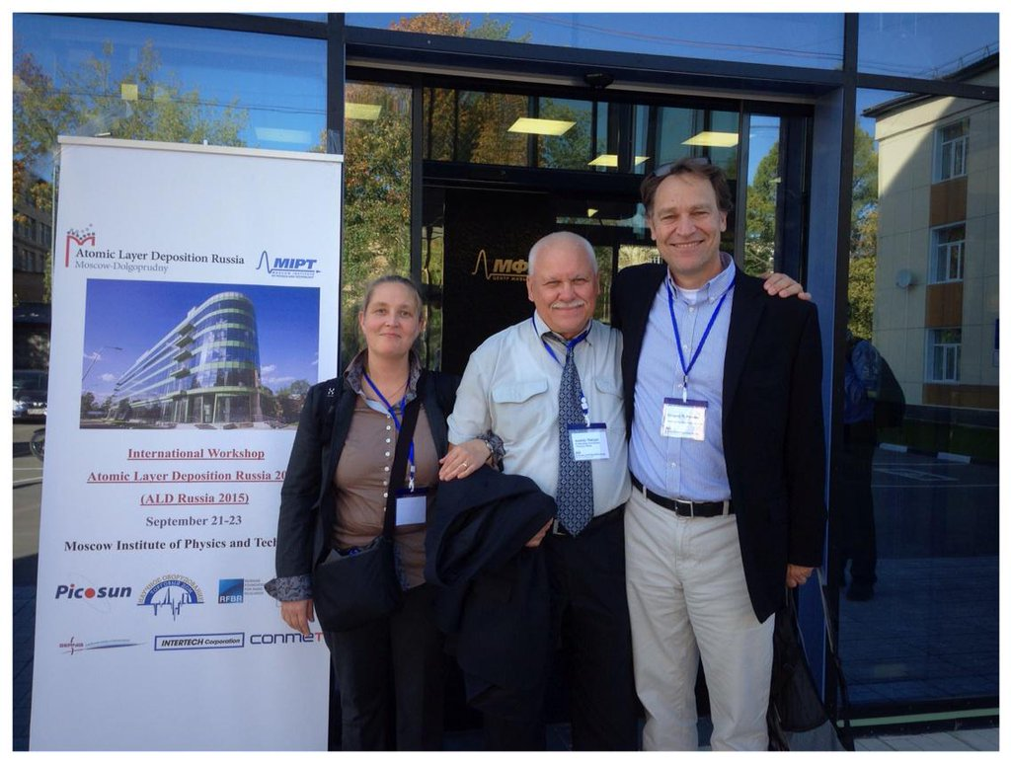
ALD Russia Moscow + Baltic ALD Tartu Sep-Oct 2015
George
ALD Russia 2015 group photo
Puurunen, Malygin, Parsons
http://www.ald-mipt.ru/ald-russia.html
http://aldhistory.blogspot.fi/2015/11/ald-russia-2015-travel-report-Puurunen.html

Slide 22
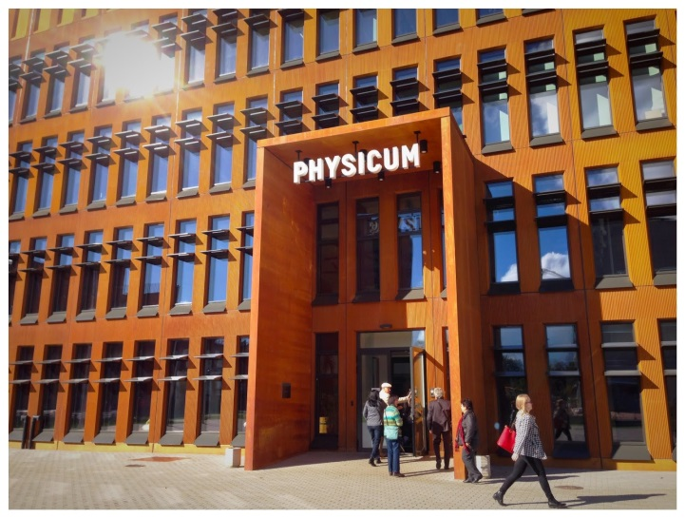
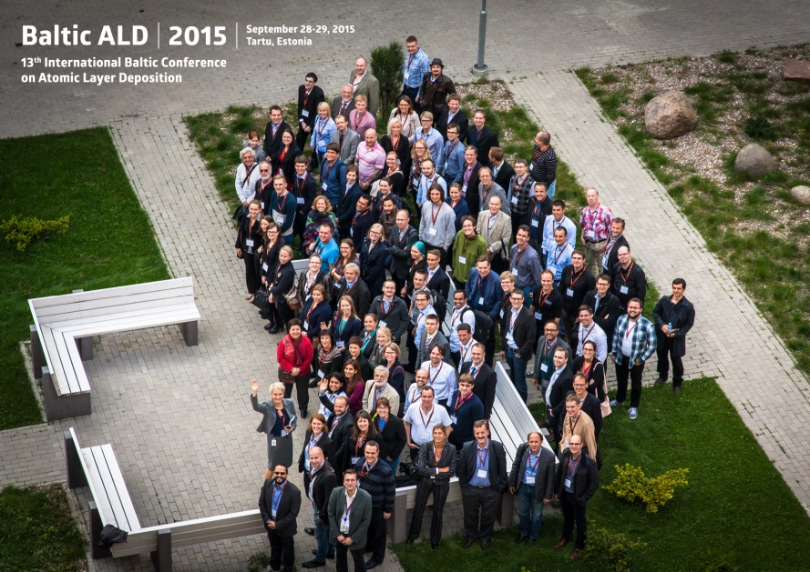
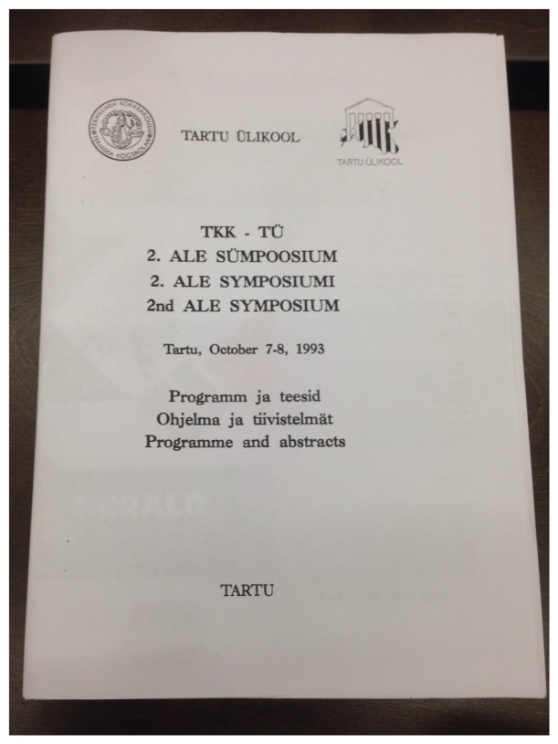
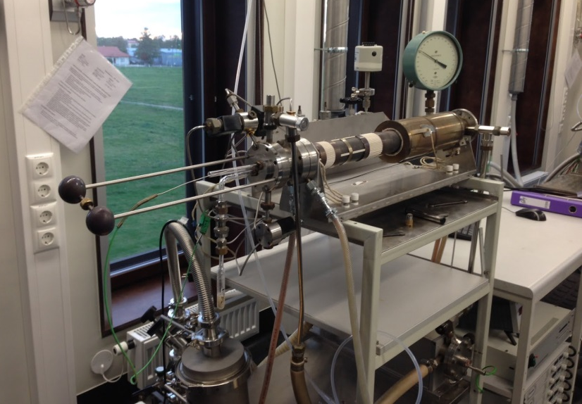
ALD Russia Moscow + Baltic ALD Tartu Sep-Oct 2015
http://www.bald2015.ee/
http://aldhistory.blogspot.fi/2016/01/baltic-ald-2015-tartu-travel-notes-puurunen.html
Reactor from 1987?

Slide 23
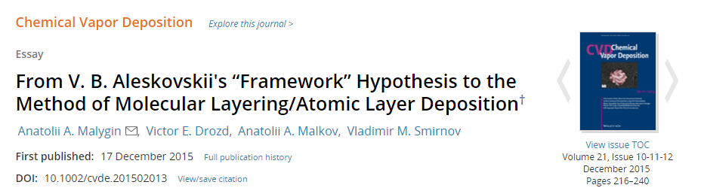
LinkedIn question May 6, 2013
VPHA opened July 25, 2013 + ALD 2013 San Diego
Publication Plan October 18, 2013 (updated Jan 13, 2014 & April 5, 2015)
Puurunen visit to St. Petersburg November 2013
Baltic ALD 2014 Helsinki: VPHA poster + FinALD40 exhibition
ALD 2014 Kyoto: history tutorial + two posters
”Suntola’s ALE essay” published Oct 15, 2014 & FinALD40 release
ALD Russia Moscow + Baltic ALD Tartu Sep-Oct 2015
“ML essay” published Dec 17, 2015
10.1002/cvde.201502013/abstract

Slide 24
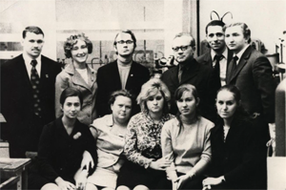
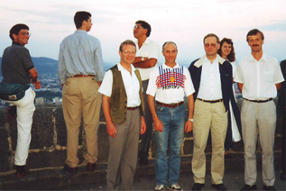
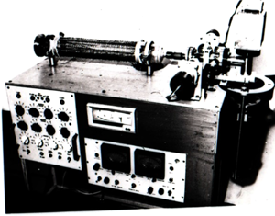
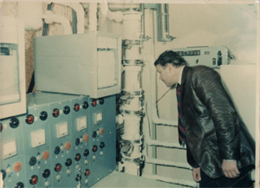

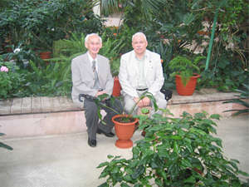
“ML essay” published Dec 17, 2015
ALE-4 Linz 1996: George, Suntola, Drozd, Niinistö, Leskelä
1973 ML group
1977 Drozd’s reactor
LTI by Lensovet
1982
column
flow unit
2004 conf. St Petersburg
Aleskovskii, Malygin
Times cited: 0
10.1002/cvde.201502013/abstract
Notes:
Members of the molecular layering research group at the Department of Chemistry of Solids at the LTI by Lensovet (from left to right: A. A. Malygin, T. V. Tuz, V. M. Smirnov, S. I. Kol'tsov, V. B. Kopylov, E. P. Smirnov; sitting second from left is A. N. Volkova, 1973). Photograph from Malygin's collections; published with permission of Anatoly Malygin (private collection).
Automatic ML installation with analog control system (1977). Photograph from Drozd's collections; published with permission of Victor Drozd (private collection).
The first experiments on the column flow unit (1982) (right – A. A. Malygin). Photograph from Malygin's collections; published with permission of Anatoly Malygin (private collection).
In the winter garden of the St. Petersburg State University during the break at the conference “Chemistry of highly organized substances and fundamental scientific basics of nanotechnology“ (2004, V. B. Aleskovskii (left) meets his student Professor A. A. Malygin). Photograph from Malygin's collections; published with permission of Anatoly Malygin (private collection).
1973 Molecular Layering group
Drozd’s thin film reactor with analog control system 1977
First experiments with column flow unit 1982
Linz (Austria) 1996

Slide 25
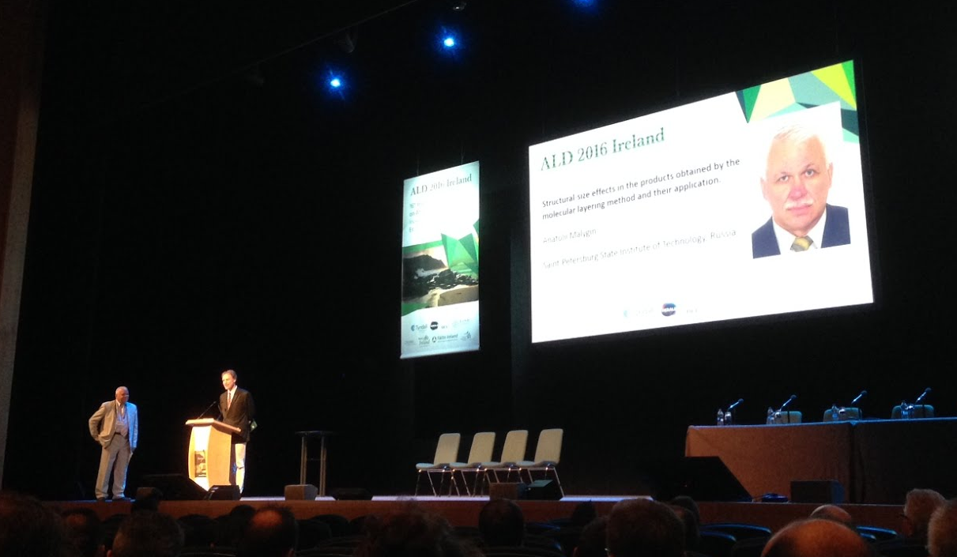
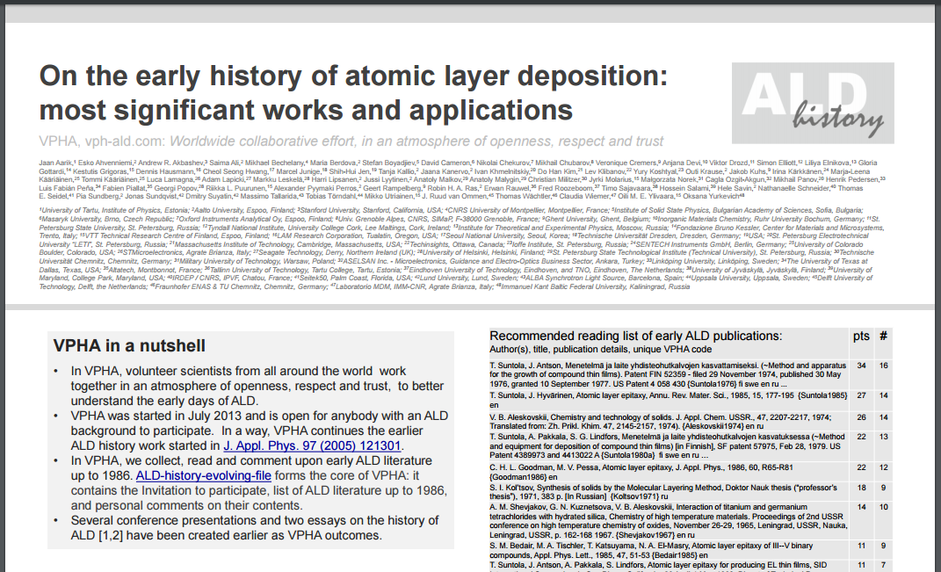
LinkedIn question May 6, 2013
http://vph-ald.com/UploadedPublications/Malygin-ALD2016-25July.pdf
VPHA opened July 25, 2013 + ALD 2013 San Diego
Malygin
Parsons
Publication Plan October 18, 2013 (updated Jan 13, 2014 & April 5, 2015)
Puurunen visit to St. Petersburg November 2013
Baltic ALD 2014 Helsinki: VPHA poster + FinALD40 exhibition
ALD 2014 Kyoto: history tutorial + two posters
”Suntola’s ALE essay” published Oct 15, 2014 & FinALD40 release
ALD Russia Moscow + Baltic ALD Tartu Sep-Oct 2015
“ML essay” published Dec 17, 2015
ALD 2016 Dublin:
Malygin invited talk
+ VPHA poster
http://aldhistory.blogspot.fi/2016/07/ald-2016-travel-notes.html
http://vph-ald.com/VPHApublications/VPHA-poster_July2016_FINAL_2016-07-19.pdf

Slide 26
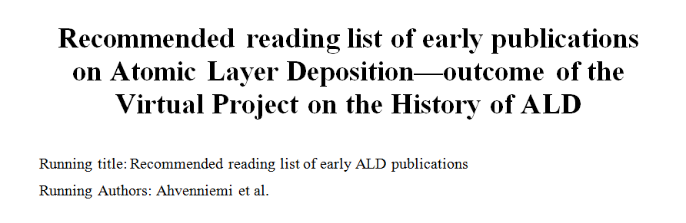
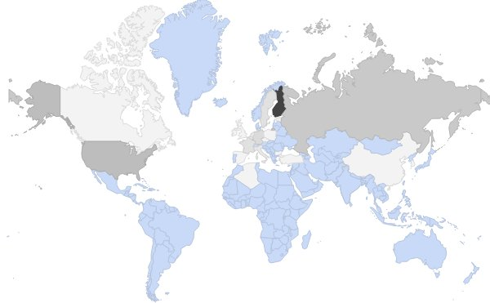
LinkedIn question May 6, 2013
VPHA opened July 25, 2013 + ALD 2013 San Diego
Publication Plan October 18, 2013 (updated Jan 13, 2014 & April 5, 2015)
Puurunen visit to St. Petersburg November 2013
Baltic ALD 2014 Helsinki: VPHA poster + FinALD40 exhibition
ALD 2014 Kyoto: history tutorial + two posters
”Suntola’s ALE essay” published Oct 15, 2014 & FinALD40 release
ALD Russia Moscow + Baltic ALD Tartu Sep-Oct 2015
62 authors, submitted Oct 30, 2016
“ML essay” published Dec 17, 2015
ALD 2016 Dublin: Malygin invited talk + VPHA poster
VPHA manuscript + Baltic ALD 2016 St. Petersburg
Darker grey → more VPHA contributors
http://aldhistory.blogspot.fi/search/label/JVSTA

Slide 27
VPHA manuscript + Baltic ALD 2016 St. Petersburg
Title | Authors | Year
Some characteristics of molecular layering reactions | Aleskovskii, Koltsov | 1965
Interaction of titanium and germanium tetrachlorides with hydrated silica | Shevjakov, Kuznetsova, Aleskovskii | 1967
Measuring thicknesses of ultra-thin silicon oxide films deposited by molecular layering on the surface of single crystal silicon using polarization method | Sveshnikova, Koltsov, Aleskovskii | 1969
Synthesis of solids by the Molecular Layering Method | Koltsov | 1971
Chemistry and technology of solids | Aleskovskii | 1974
Method and apparatus for the growth of compound thin films | Suntola, Antson | 1974*
Synthesis and study of oxide coatings obtained by molecular layering on semiconductor surfaces | Drozd | 1978
Atomic layer epitaxy for producing EL thin films | Suntola, Antson, Pakkala, Lindfors | 1980
Atomic layer epitaxy | Suntola, Hyvärinen | 1985
Atomic layer epitaxy of III-V binary compounds | Bedair, Tischler, Katsuyama, El-Masry | 1985
Molecular Layer Epitaxy | Nishizawa, Abe, Kurabayashi | 1985
Shortened from: VPHA manuscript (62 authors), submitted to JVSTA (2016).

Slide 28
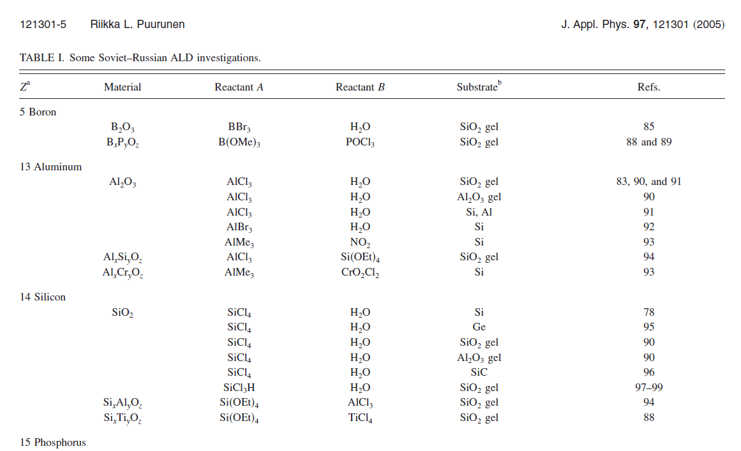
VPHA manuscript + Baltic ALD 2016 St. Petersburg
catalysts by ALD from 1972,⁵⁴ geometrical modelling of surface site filling during ALD from 1975,⁵⁵ particle coating in a fluidized bed from 1979,⁵⁶ ALD with an electric field to guide the growth from 1981,⁵⁷ quantum chemical modelling from 1983,⁵⁸ amine-catalyzed SiO₂ ALD from 1984,⁵⁹ ALD on polymers from 1984,⁶⁰ and the proposal of photo ALD from 1984.⁶¹
From: VPHA manuscript (62 authors), submitted to JVSTA (2016).

Slide 29
Conclusion & outlook
ALD discovered & developed
independently twice
VPHA reading still continues,
new volunteers welcome
  >300 comments still needed
ALD-history-evolving-file: growing reference source
Worldwide ALD-related lists under construction
  Conferences, theses (PhD + higher), review articles
More info: http://vph-ald.com & ALD History Blog http://aldhistory.blogspot.fi
Contact: info@vph-ald.com

Slide 30
Acknowledgements
General support: Tuomo Suntola, Anatoly Malygin, Victor Drozd
Initiation of VPHA: Aziz Abdulagatov, Annina Titoff; RLP St. Petersburg visit: Mikko Kaarela; Wikipedia updates Angel Yanguas-Gil; translation of Japanese ALD paper Christian Dussarrat
VPHA co-authors (as of 1.10.2016): Jaan Aarik, Esko Ahvenniemi, Andrew R. Akbashev, Saima Ali, Mikhael Bechelany, Maria Berdova, Stefan Boyadjiev, David Cameron, Nikolai Chekurov, Rong Chen, Mikhail Chubarov, Veronique Cremers, Anjana Devi, Viktor Drozd, Simon Elliott, Liliya Elnikova, Gloria Gottardi, Kestutis Grigoras, Dennis Hausmann, Cheol Seong Hwang, Marcel Junige, Shih-Hui Jen, Tanja Kallio, Jaana Kanervo, Ivan Khmelnitskiy, Do Han Kim, Lev Klibanov, Outi Krause, Jakob Kuhs, Irina Kärkkänen, Marja-Leena Kääriäinen, Tommi Kääriäinen, Luca Lamagna, Adam Lapicki, Markku Leskelä, Harri Lipsanen, Jussi Lyytinen, Anatoly Malkov, Anatoly Malygin, Abdelkader Mennad, Christian Militzer, Jyrki Molarius, Małgorzata Norek, Cagla Ozgit-Akgun, Mikhail Panov, Luis Fabián Peña, Fabien Piallat, Georgi Popov, Alexander Pyymaki Perros, Geert Rampelberg, Robin H. A. Ras, Erwan Rauwel, Fred Roozeboom, Timo Sajavaara, Hossein Salami, Hele Savin, Nathanaelle Schneider, Thomas E. Seidel, David C. Smith, Pia Sundberg, Dmitry Suyatin, Massimo Tallarida, Tobias Törndahl, Mikko Utriainen, Thomas Wächtler, Claudia Wiemer, Oili M. E. Ylivaara
American Vacuum Society AVS
Partial funding of RLP: Finnish Centre of Excellence in Atomic Layer Deposition by Academy of Finland
HERALD COST MP1402 Action

Slide 31
Thank you, questions? СПАСИБО, ВОПРОСЫ?
атомно-слоевое осаждение
原子层沉积
Deposição por Camadas Atômicas
Oсадження атомних шарів
Atomikerroskasvatus
Atomik Katman Biriktirme
Aatomkihtsadestus
आण्विक थर लेप
Atomlagenabscheidung
परमाणु परत निक्षेपण
원자층증착
Atomic Layer Deposition
Atoomlaagdepositie
Atomlagerdeponering
Depositación de Capas Atómicas
Deposizione a Strati Atomici
Parmanu Parat Nishepan
Mолекулярное Hаслаивание
εναπόθεση ατομικού στρώματος
Atomlagsdeponering
שכבות אטומיות השקעת
Dépôt de Couches Atomiques
Dépôt Chimique en Phase Vapeur à Flux Alternés
原子層堆積
ALD name collection in LinkedIn ALD – Atomic Layer Deposition
Notes:
Thank you for your attention СПАСИБО ЗА ВНИМАНИЕ!
ВОПРОСЫ?

